Slide 1
Binomial Heap

Slide 2
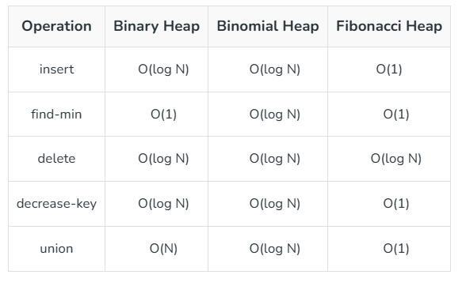
Binomial Heap
A binomial heap is a collection of binomial trees

Slide 3
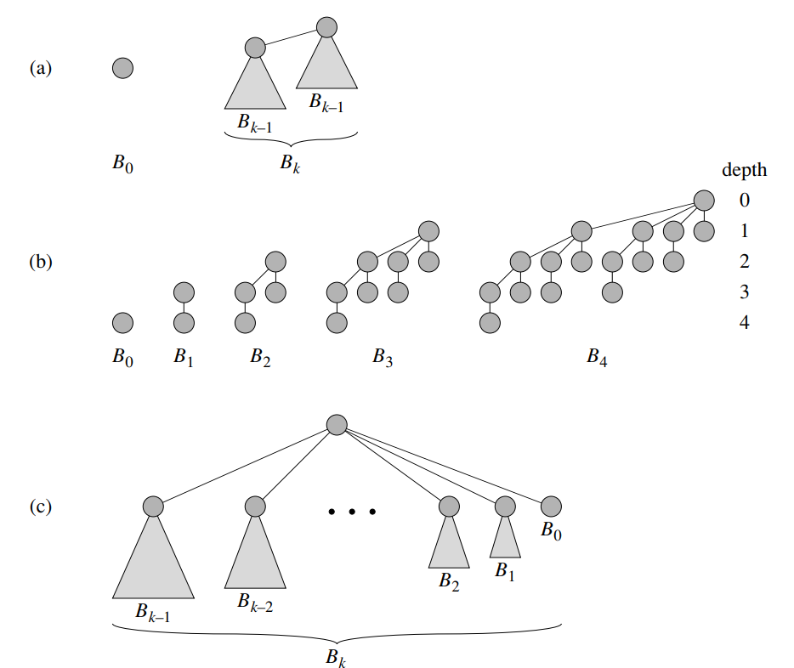
Binomial Tree
The binomial tree Bk is an ordered tree defined recursively

Slide 4
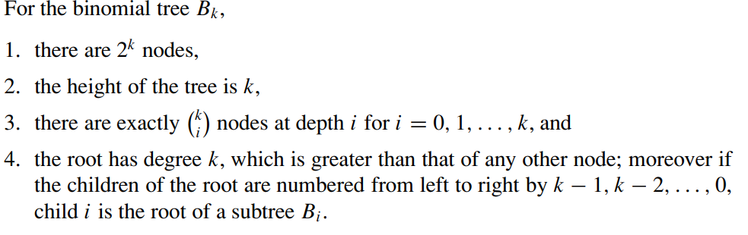
Properties of Binomial Tree

Slide 5
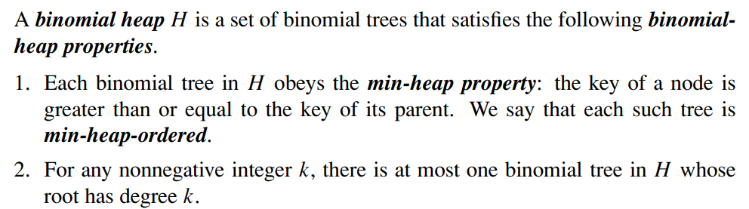
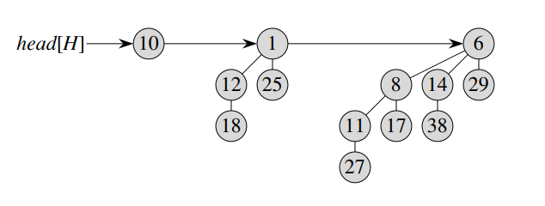
Binomial Heap

Slide 6
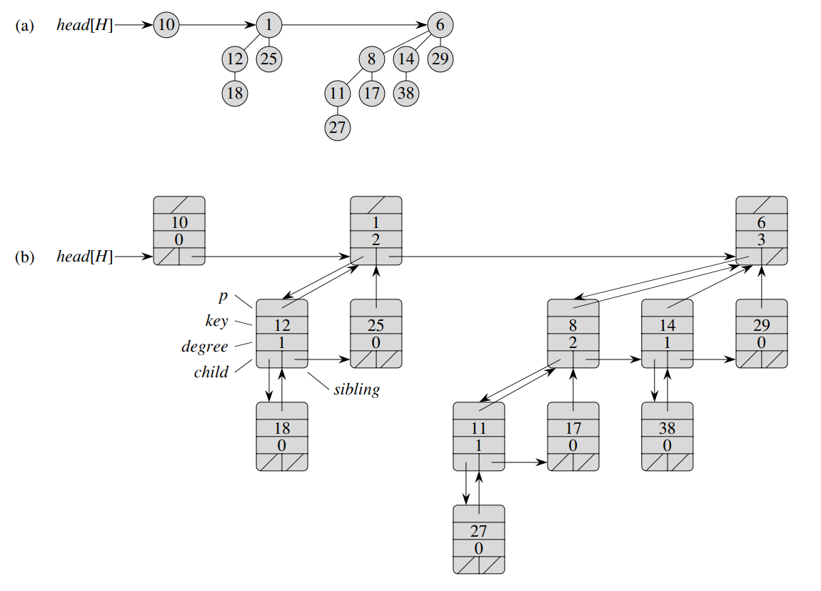
Representation of Binomial Heap

Slide 7
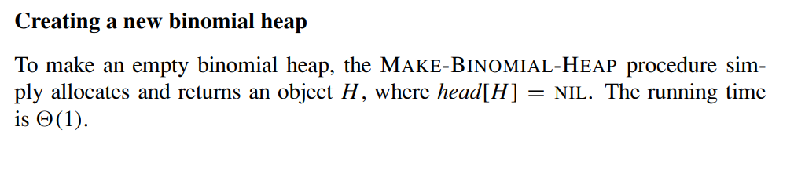
Operations on Binomial Heap

Slide 8
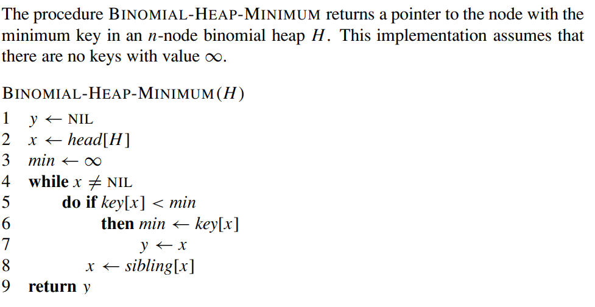

Find min Key

Slide 9
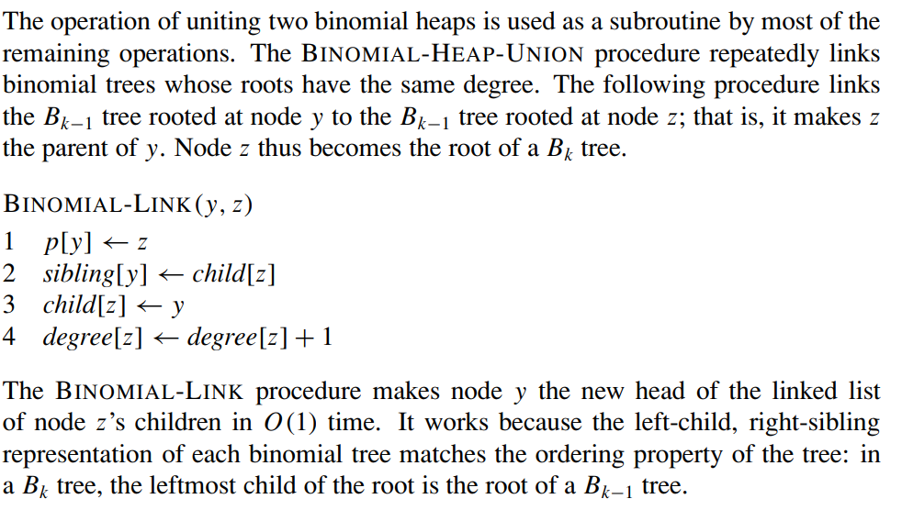
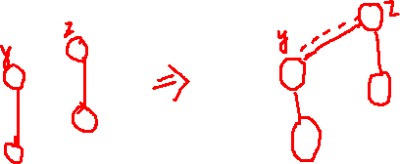
Link Binomial heaps

Slide 10
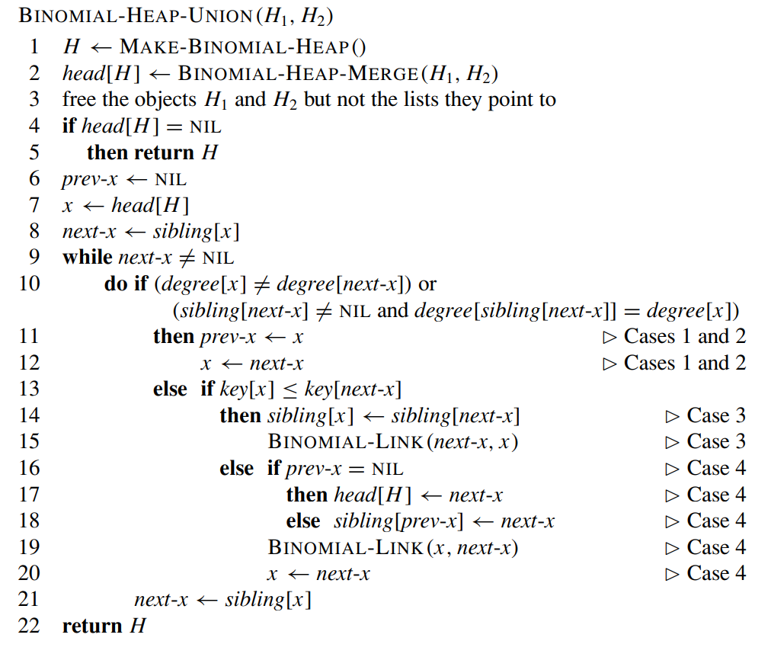
Binomial Heap Union

Slide 11
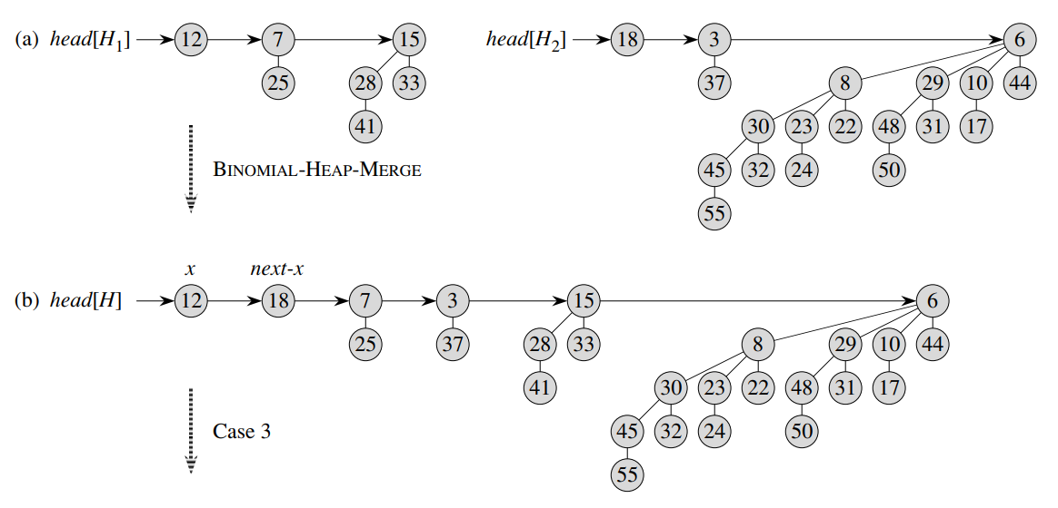
Binomial Heap Union Example

Slide 12
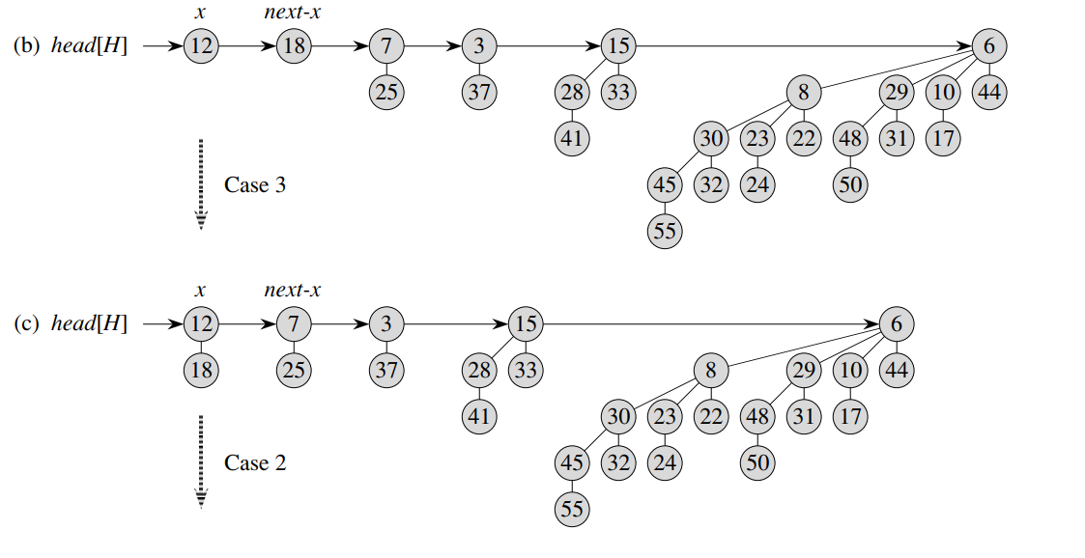
Binomial Heap Union Example (contd…)

Slide 13
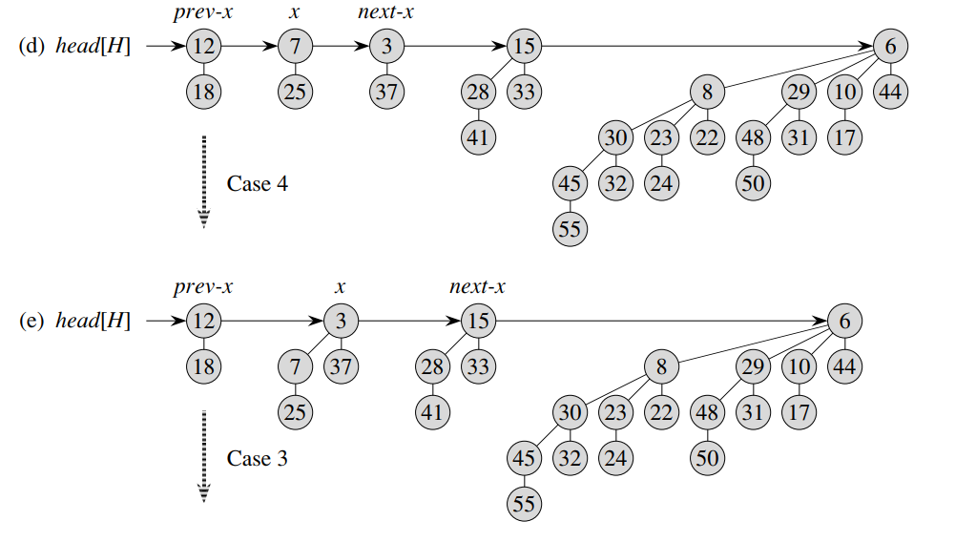
Binomial Heap Union Example (contd…)

Slide 14
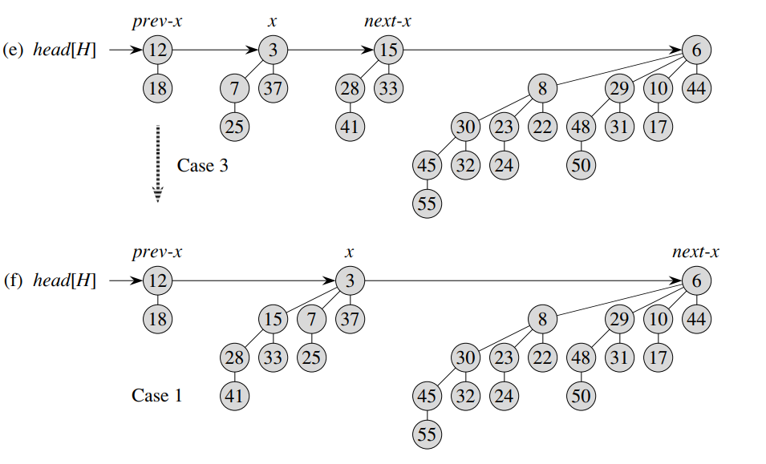
Binomial Heap Union Example (contd…)

Slide 15
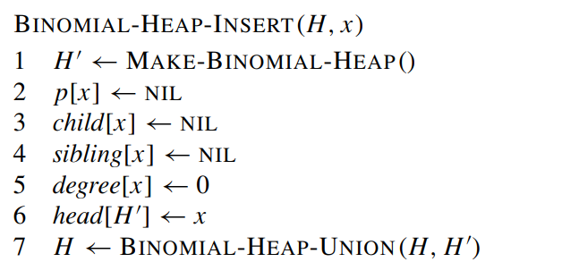
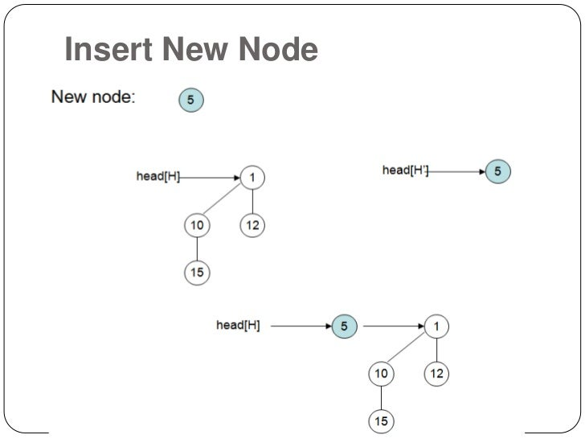
Insert a node in Binomial Heap

Slide 16
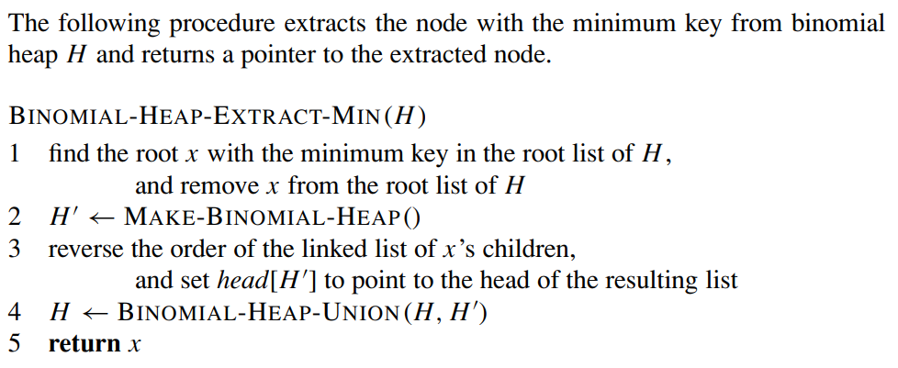
Extracting the node with minimum key

Slide 17
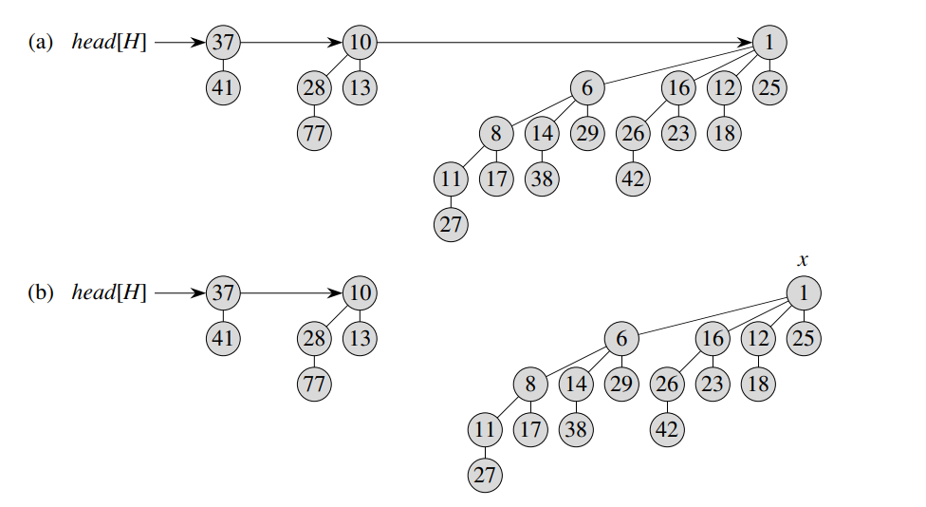
Extracting the node with minimum key Example

Slide 18
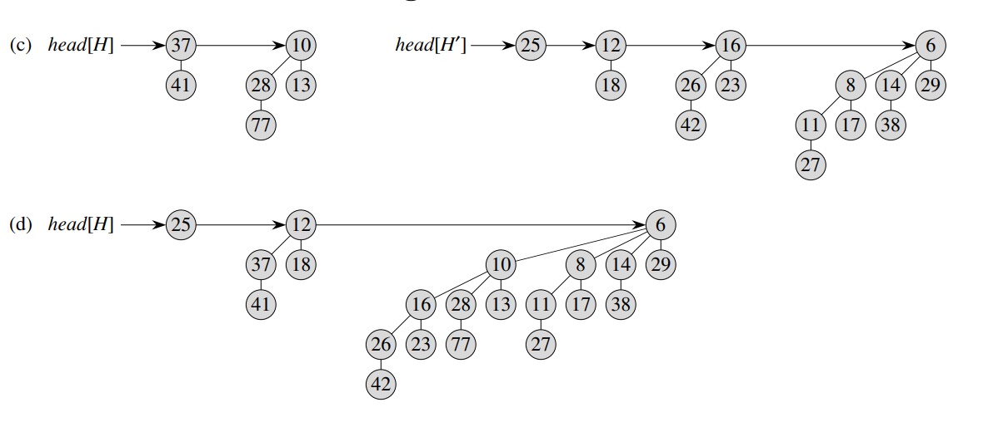
Extracting the node with minimum key Example(contd…)

Slide 19
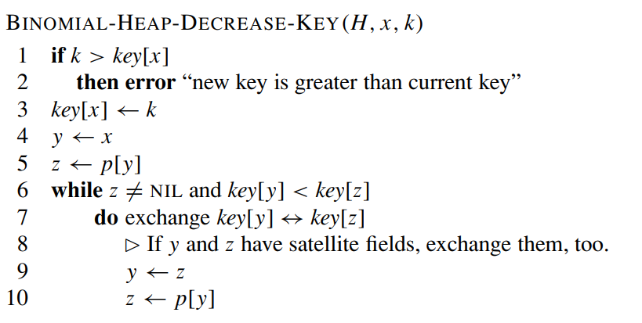
Decreasing a key

Slide 20
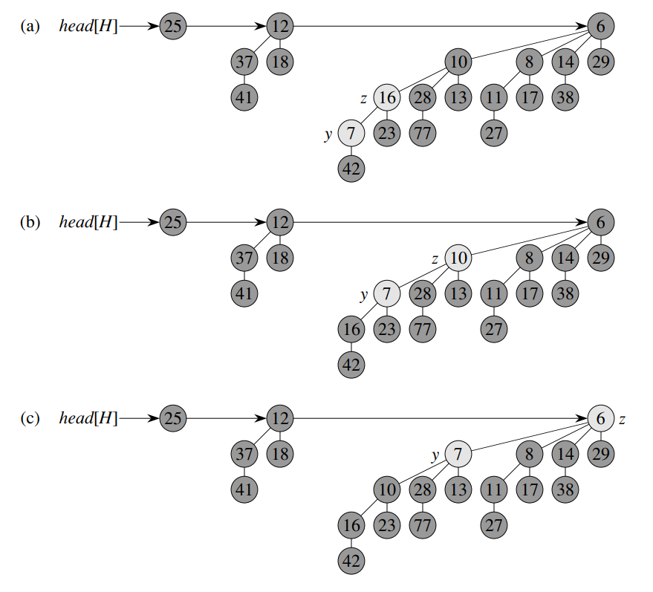
Decreasing a key - Example

Slide 21
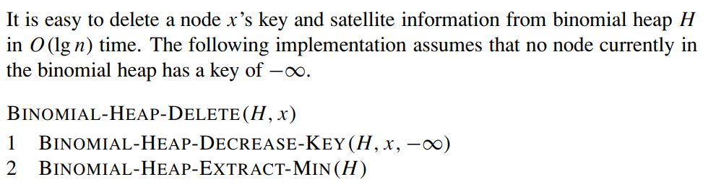
Delete a Key

Slide 22
Advantages of Binomial Heap
In summary, a binomial heap is a powerful data structure that combines the advantages of a binary heap with the ability to merge heaps quickly. Its structure of binomial trees ensures that operations can be performed efficiently, making it a useful tool in many applications

Slide 23
References
binomial-heaps.pdf (toronto.edu)
Binomial Heap - GeeksforGeeks

